Slide 1

CIS 4730 Project - Northeast Airlines
Emory Ellis, Jenny Zhenya Tacker, Navjit Singh, Sean Koo, Chris Norris

Slide 2

Business Problem
Identify customer dissatisfaction with Northeast Airlines as rewards members have declined in the previous year. Use internal and external data to improve customer satisfaction and retention to increase net profit in 2023.

Slide 3
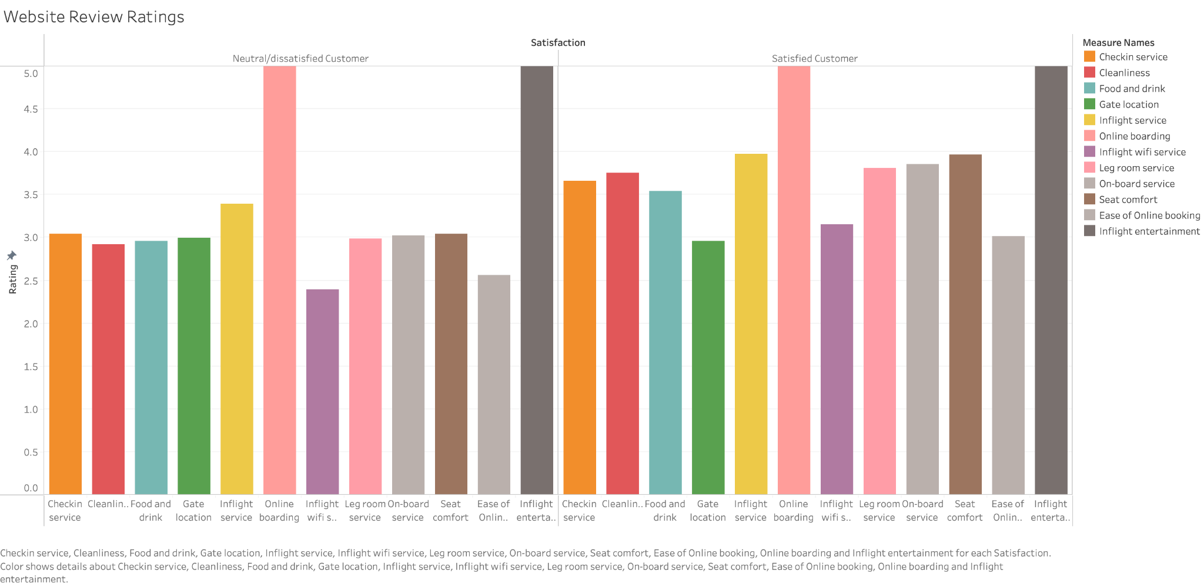
Survey App Reviews

Slide 4
Top 3
Bottom 3
Online Boarding
In-flight Entertainment
In-flight Service
Dissatisfied Customers:
Inflight Wifi Service
Ease of Online Booking
Cleanliness
Satisfied Customers:
Gate Location
Ease of Online Booking
In-flight Wifi Service

Slide 5
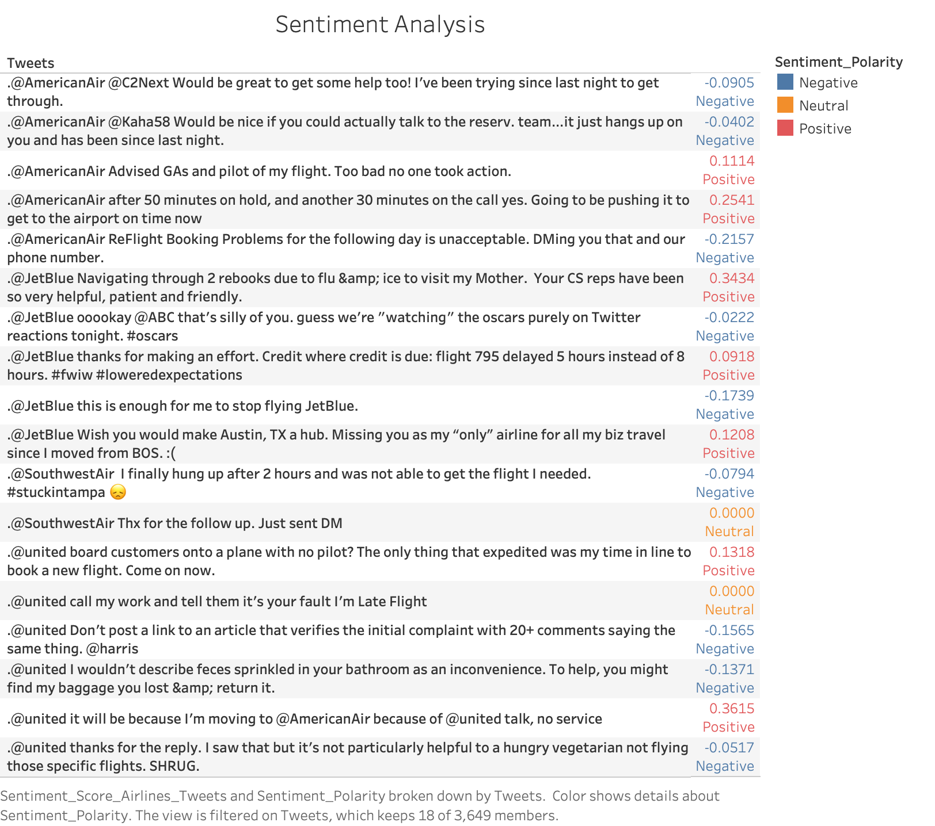
Unstructured Data: Sentiment Analysis (SA)
With the growth of social media platforms, the interactions between businesses and customers are rapidly evolving. This has led to the generation of vast volumes of unstructured data.
We used Sentiment Analysis (SA) on Twitter data to gain deeper understanding of our customer satisfaction.

Slide 6
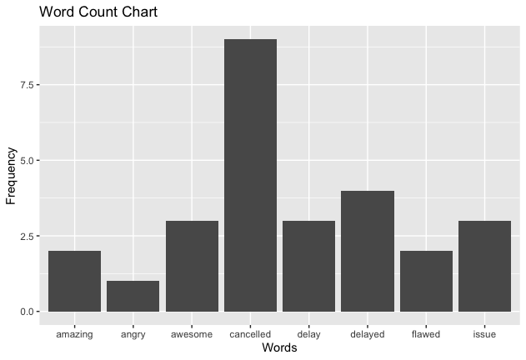
Unstructured Data: Word Count
Using R and ChatGPT, we used the ggplot function to create a visualization of the number of instances certain words appeared in the ‘text’ attribute of our review dataset.
Information such as this can help management determine what keywords are trending in reviews, which can lead to improved business decisions or even point out areas that need improvement that otherwise would have gone overlooked.
‘Cancelled’ was the keyword with the highest number of instances, which would lead management to know that cancelled flights affected their business the most during the time period in which this data was gathered.

Slide 7

Issues & Errors Challenged?
Benefits Encountered?
Accurate Prediction:
Improved Decision-Making
Faster growth
Data we acquire can be very flexible
Not constrained due to lack of schema
Highly scalable
Indexing the data became difficult and error prone
Unclear structures did not have any predefined attributes
Had led to search results being not very accurate
Difficult to store and manage certain unstructured data
Due to lack of schema and structure
(Disadvantages)
(Advantages)

Slide 8
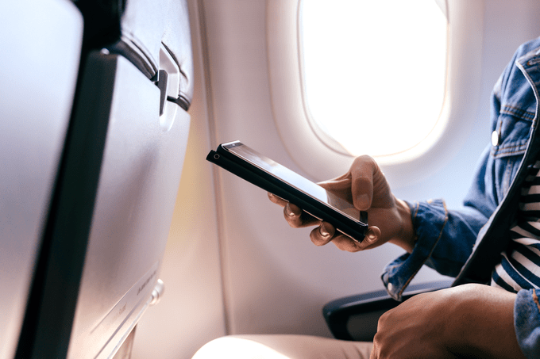
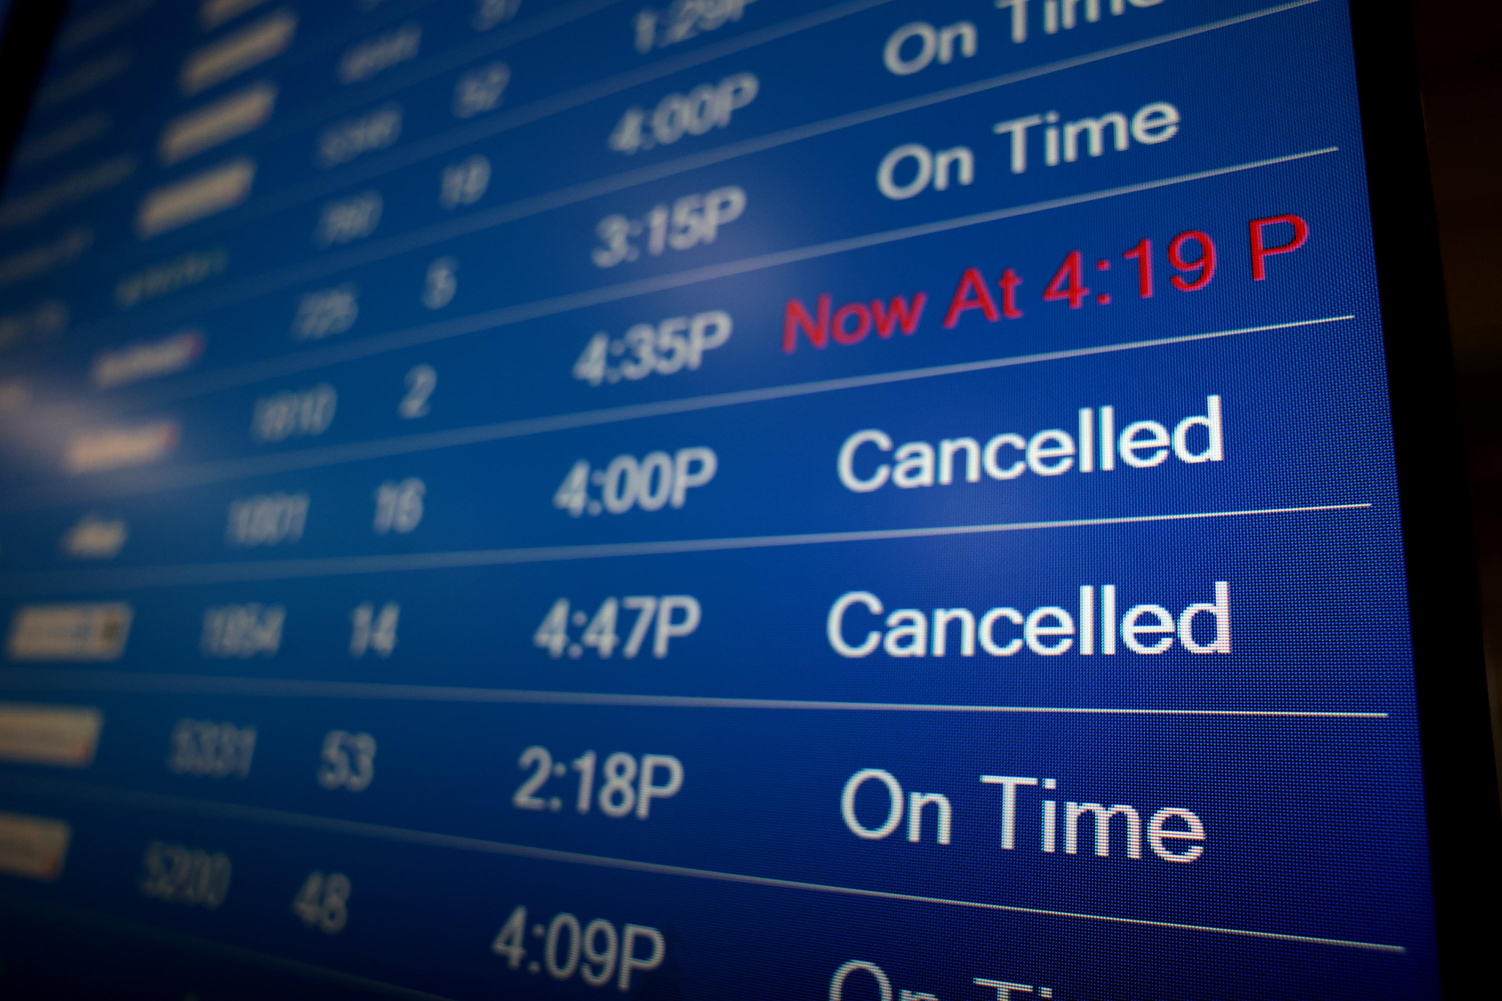
Wrap Up
By evaluating unstructured data through twitter, we were able to find that our customers tweeted often with a negative sentiment, one customer tweeted they had issues with our inflight meals and others were frustrated about flight delays.
Using structured data in the surveys that we used, our analysis efforts concluded that: inflight Wifi service, ease of inflight booking, cleanliness contributed to negative reviews.
By finding tweets that emphasized the most specific phrases, our analysts found the phrase: “cancelled” popped up the most often.

Slide 9

Conclusion & Recommendations
Following the analysis of trends found by our analysts, we have come to the conclusion that customers were dissatisfied with: inflight booking options, inflight wifi services, and flight arrival schedules.
If changes were made to these areas, then we can fix issues regarding customer complaints and fix our bottom line of our customer base and subsequently increase the value of our loyalty program.

Slide 10
Resources
Structured Data Survey via Kaggle: https://www.kaggle.com/code/marian447/skytrax-airline-survey-appears-biased
Unstructured Data Sentiment (Tweets) via Kaggle: https://www.kaggle.com/datasets/vedaangchopra/twitter-us-airline-sentiment-dataset
Unstructured Dataset via GeeksforGeeks: What is Unstructured Data? - GeeksforGeeks

